Slide 1

ATLIQ GRANDS ANALYSIS
PRESENTED BY : RAVI

Slide 2

INDEX
Company Overview
Business Model
Problem statement
Goals and objective
Dashboards
Insight and Recommendation

Slide 3
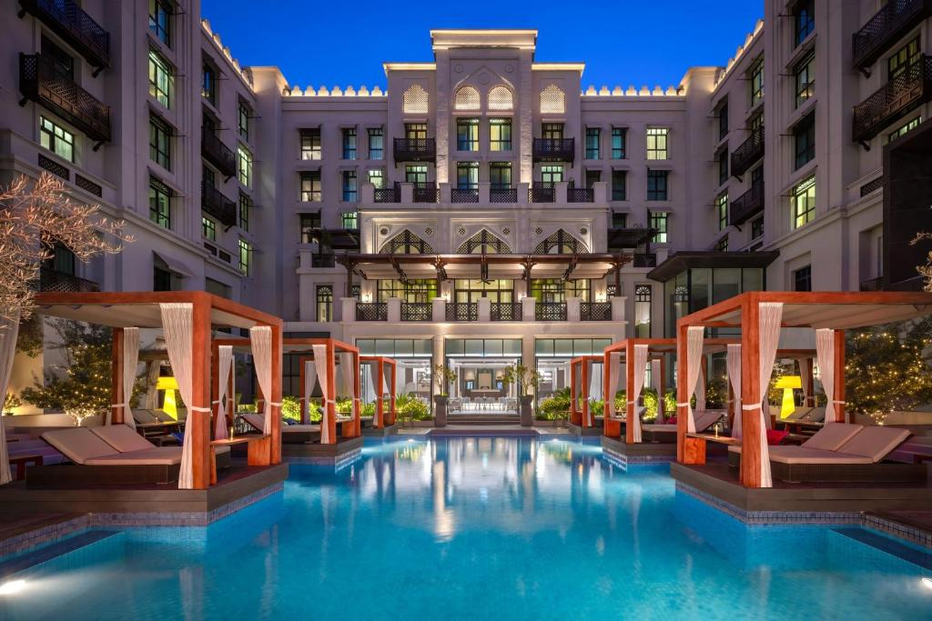
OVERVIEW OF ATLIQ GRAND
AtliQ Grands is a prominent luxury hospitality brand managing multiple five-star hotels across India. With 20 years of experience in the industry, they are known for delivering premium experiences to business and luxury travelers. However, recent strategic missteps and strong competition have impacted their market share and revenue. To address these challenges, they aim to leverage Business and Data Intelligence insights. Without an in-house data analytics team, AtliQ Grands has opted to collaborate with a third-party provider to analyze their historical data for actionable insights.

Slide 4
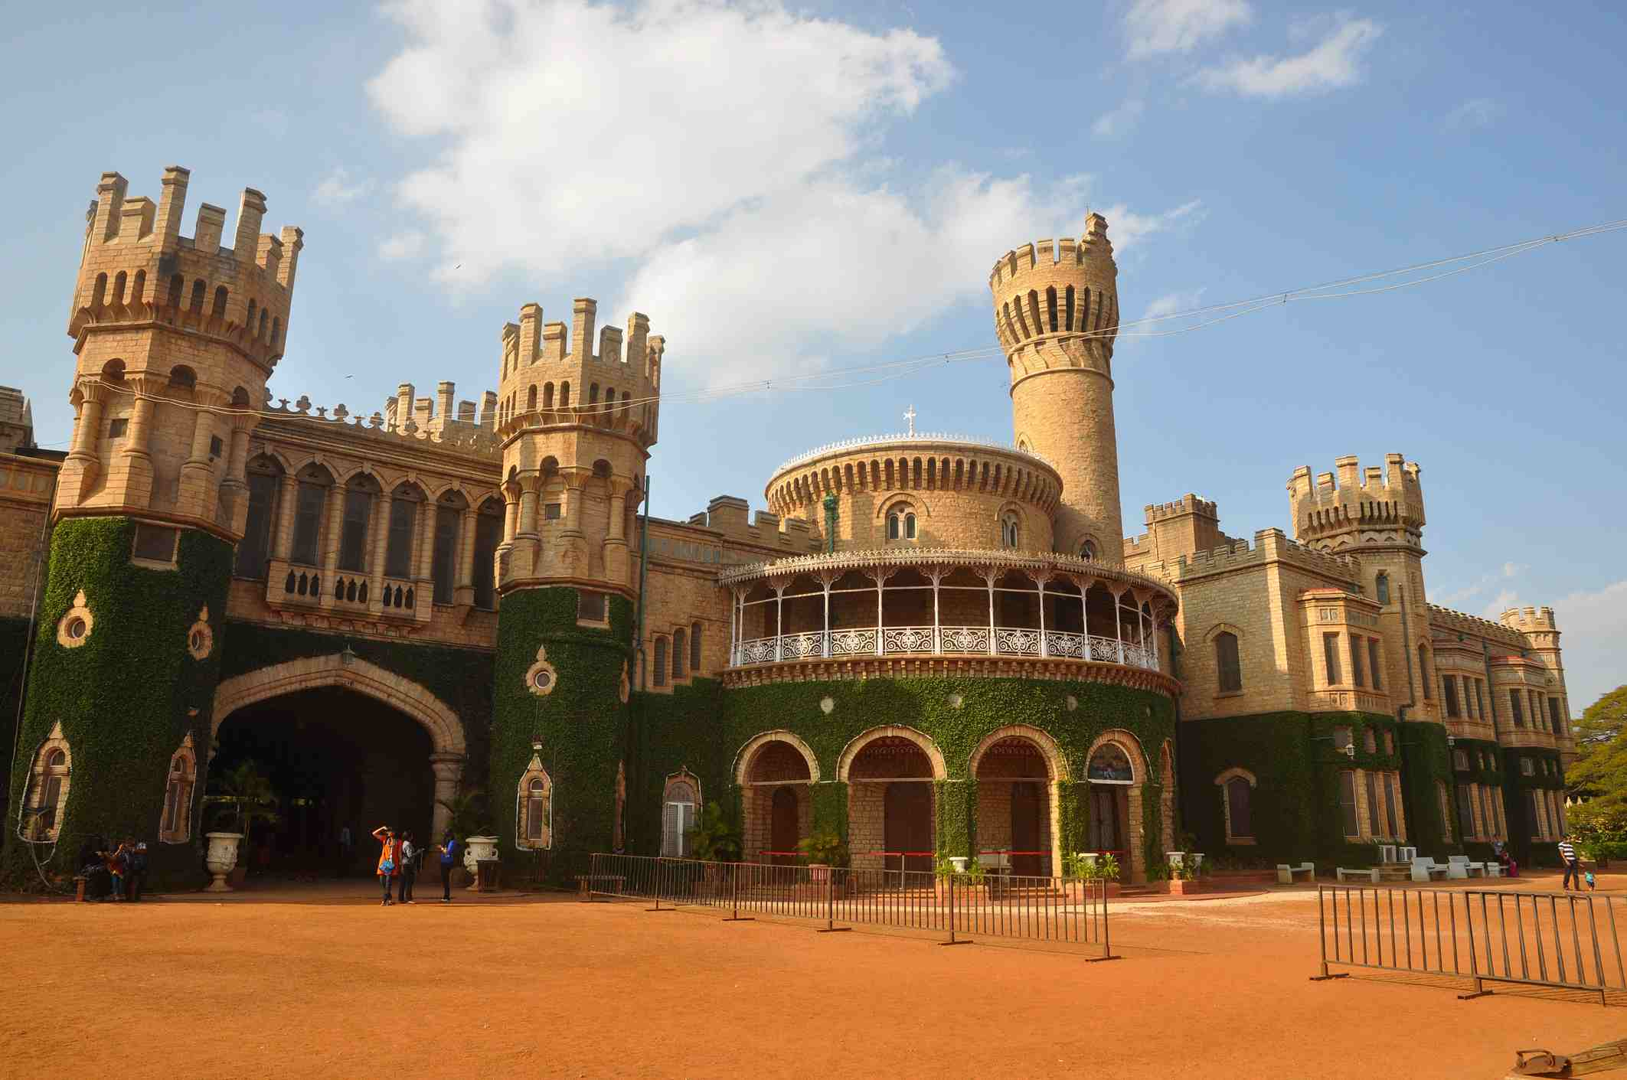
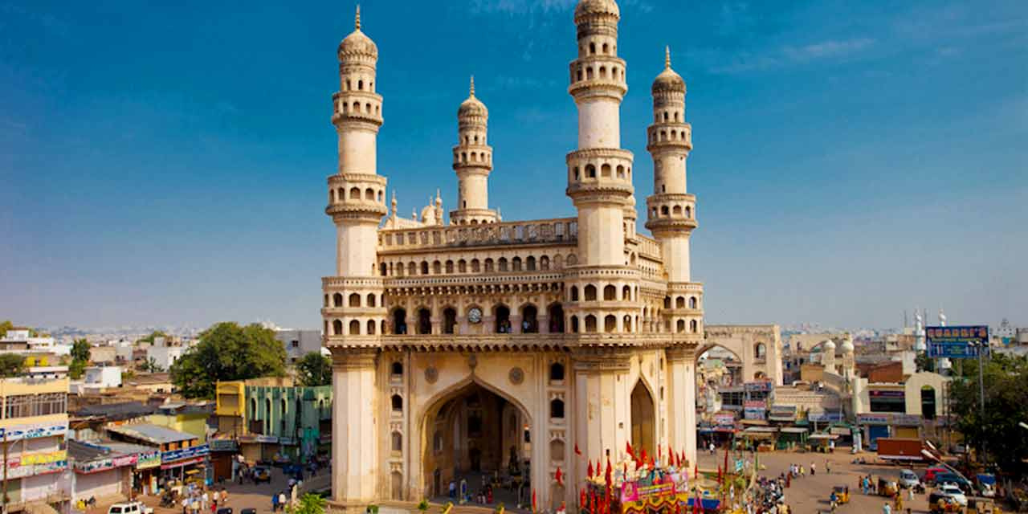
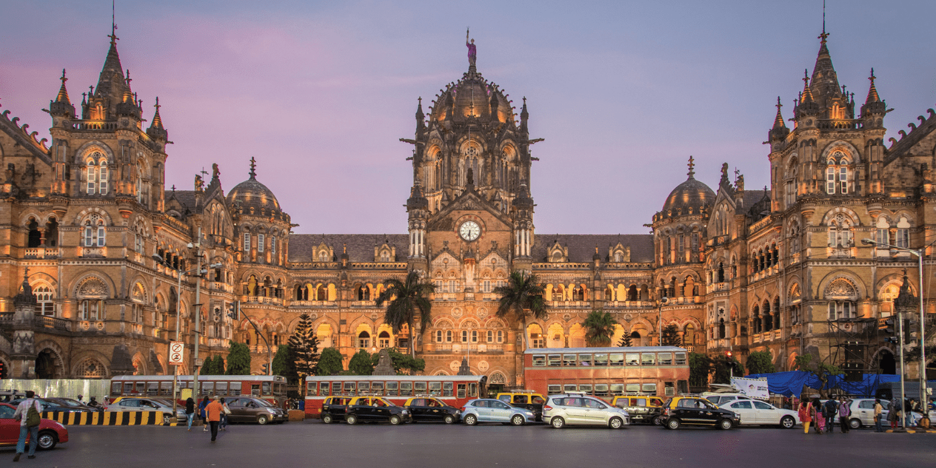
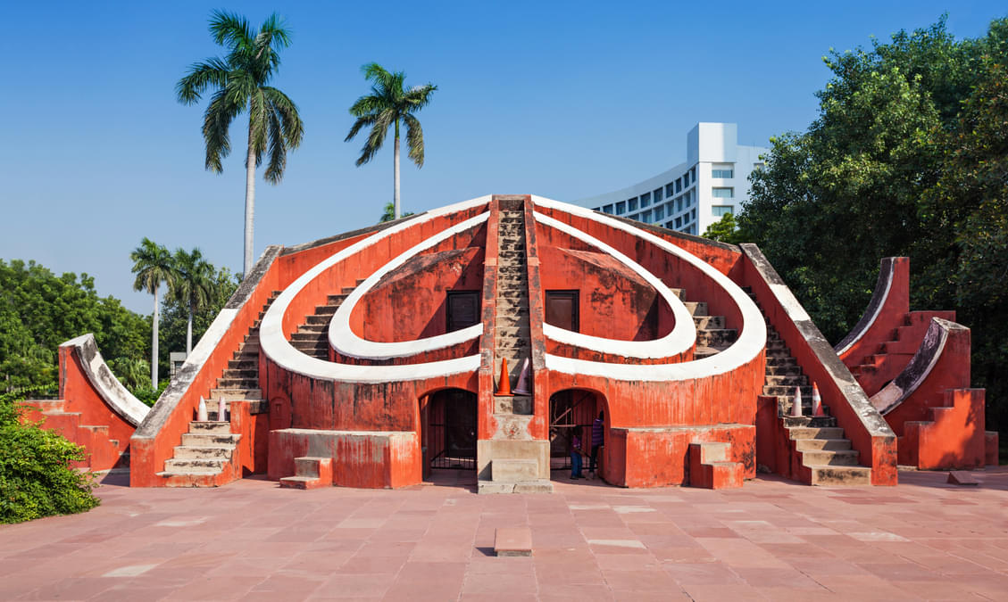
LOCATION
Bengaluru
Hyderabad
Mumbai
Delhi

Slide 5

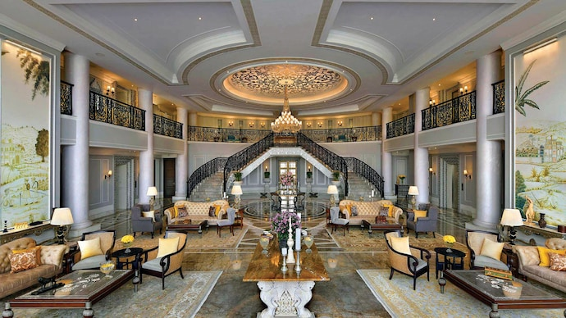
HOTEL TYPE
Business Hotel
Luxury Hotel

Slide 6
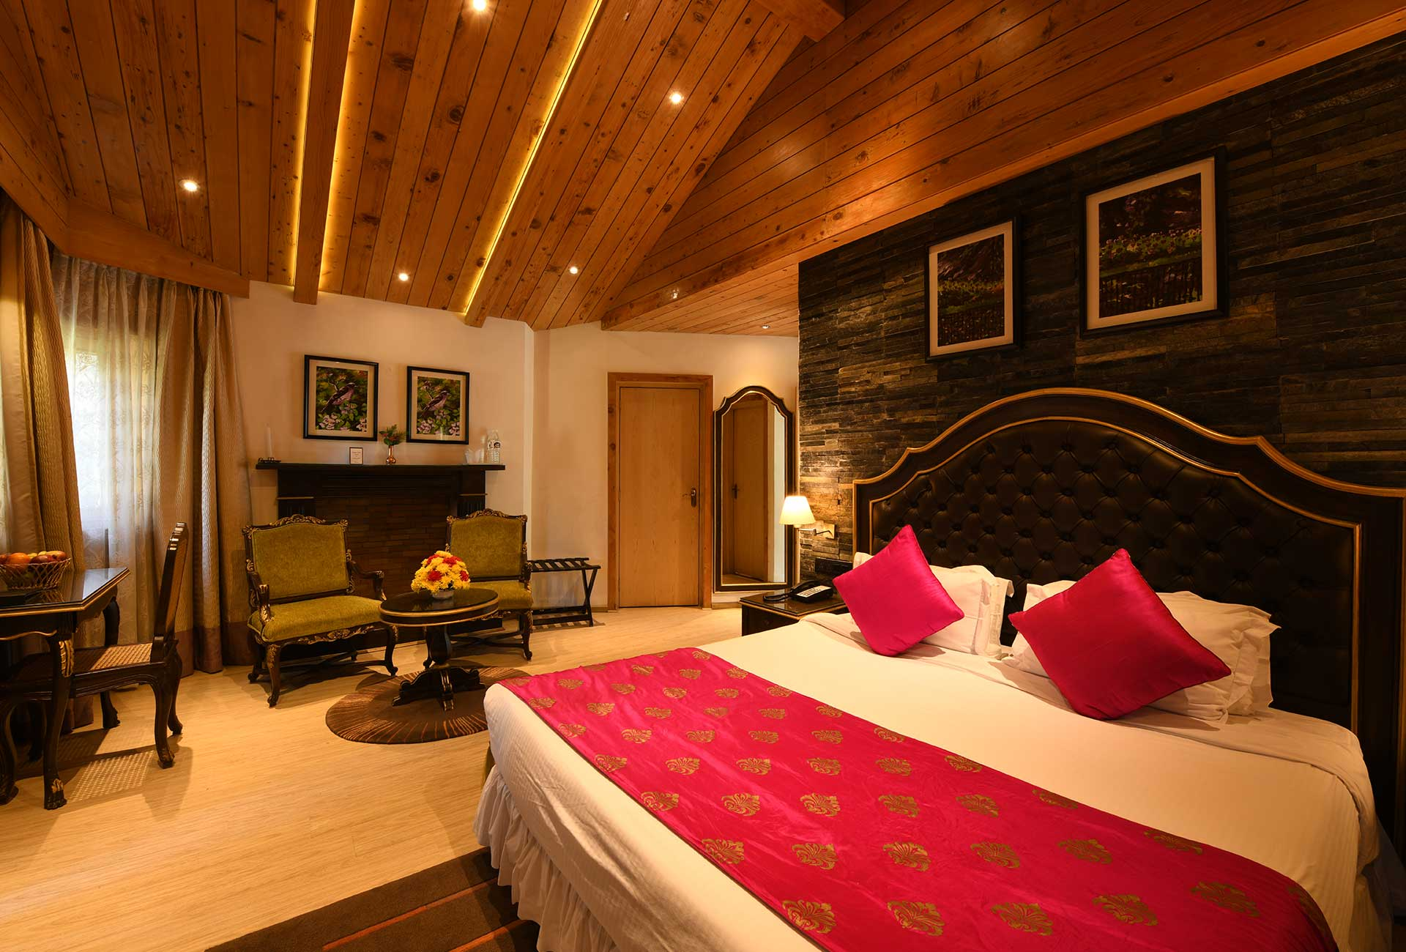
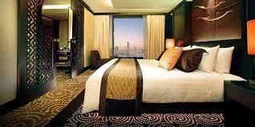
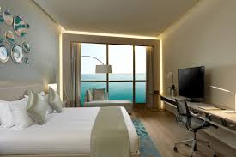
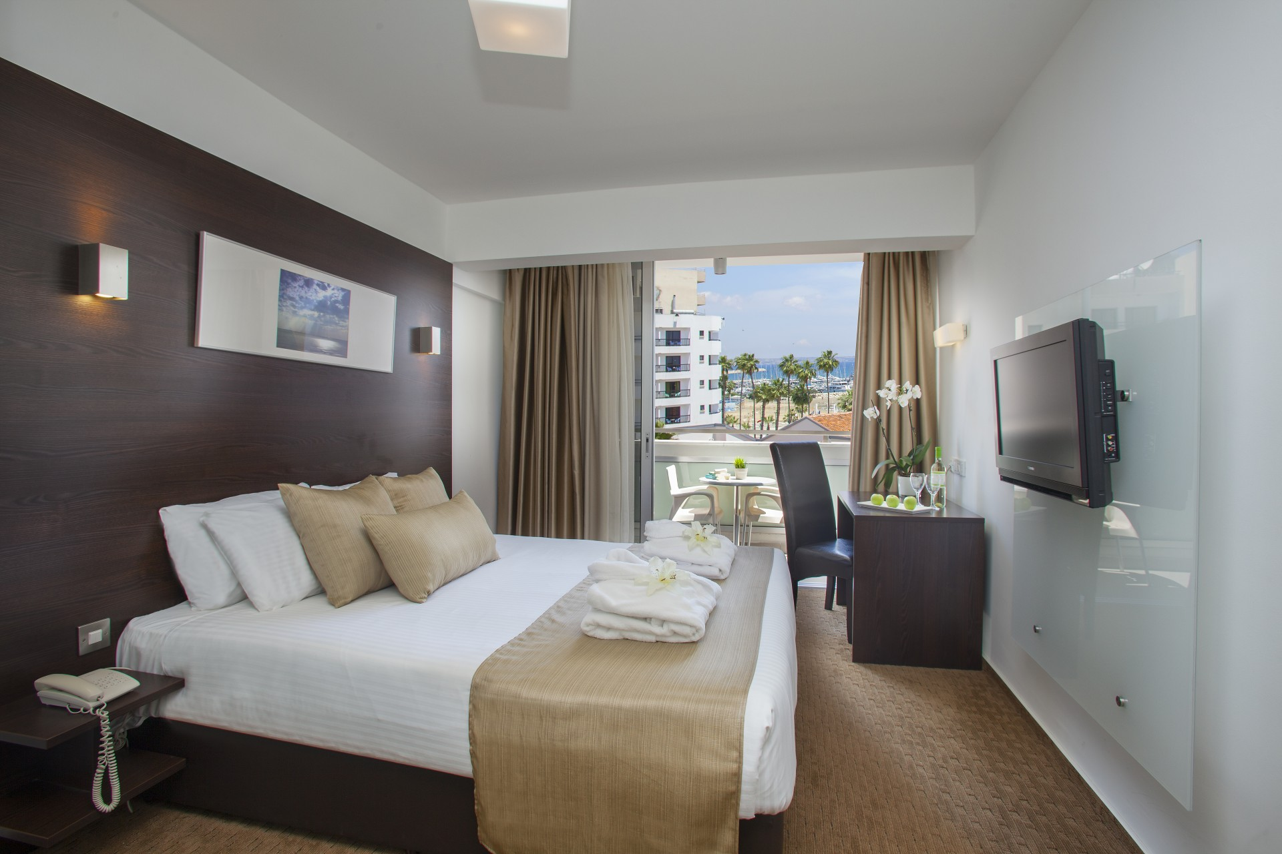
ROOM CLASS
Elite
Presidential
Premium
Standard

Slide 7

PROBLEM STATEMENT
AtliQ Grands, a leading name in India's luxury and business hotel industry for over 20 years, is facing a tough time. Their market share and revenue are dropping due to growing competition and internal decision-making issues. To tackle this, they plan to use business and data intelligence. Since they don’t have an in-house analytics team, they will hire an external service provider to analyze their historical data and help them make smarter decisions.

Slide 8

GOAL
AtliQ Grands aims to analyze data from all channels to create key metrics and visuals. The goal is to develop a user-friendly dashboard for stakeholders to identify gaps, make smarter decisions, and boost revenue, enabling the opening of new hotels in the coming quarters.

Slide 9
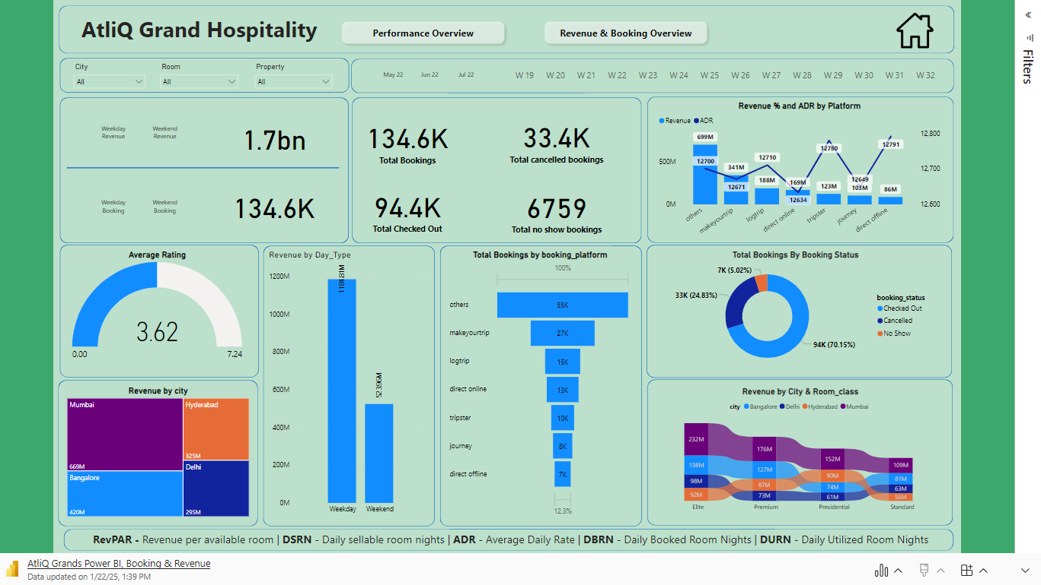

Slide 10

INSIGHTS
Mumbai generates the highest revenue among all cities, with AtliQ Exotica contributing an impressive ₹669 million.
Delhi, despite having the highest average customer rating, recorded the lowest revenue at ₹290 million.
A large share of revenue comes from luxury hotels.
MakeMyTrip ranks second among all booking platforms for the number of bookings.
AtliQ Exotica and AtliQ Palace are the top revenue contributors, making up 18.75% and 17.80%, respectively. Both hotels have strong average ratings of 3.6 and 3.75, showcasing their excellent performance.
Weekdays bring in the highest revenue, totaling ₹1.16 billion.
Elite and premium rooms generate the most revenue among all room types.

Slide 11

RECOMMENDATION
Bengaluru has good revenue but the lowest average rating. To improve, focus on enhancing customer experience by training staff, upgrading facilities, and gathering regular feedback.
Delhi has high ratings but lower revenue. Use targeted marketing to attract more visitors and adjust pricing strategies to increase revenue.
Business hotels earn less revenue compared to luxury hotels despite similar ratings. Improve the guest experience in business hotels by upgrading amenities, enhancing service quality, and using marketing strategies to attract higher-paying guests.
Presidential rooms show high occupancy but low revenue. Reassess pricing strategies and focus on improving customer experience to maximize revenue.

Slide 12


Thank you.
Thank you for viewing this presentation. I welcome the opportunity to connect on LinkedIn or GitHub to explore further discussions, share insights, or collaborate on future projects. Feel free to reach out!

